Slide 1

Cellular automata and nature inspired computing
http://pavolondzik.github.io/GoL/
Pavol Ondzik
Denzel Dadson

Slide 2
Cellular Automaton
Can be used for simulation of:
Cancer cells growth
Forest Fires
Social Movement
Predator – Prey Models
Art
Biological Processes
Ref: 1

Slide 3


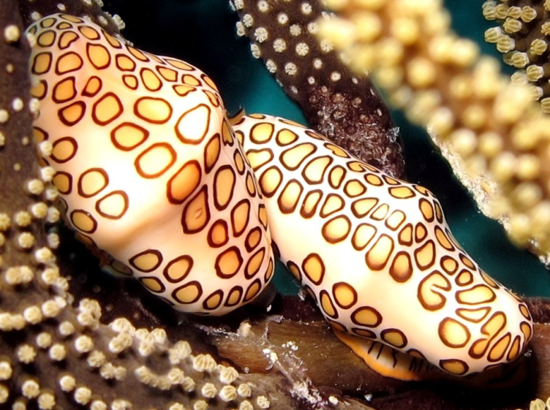

Patterns in nature
Royal Angelfish
Zebra
Flamingo tongue snail
Leopard skin spots
Ref: 2, 3
Notes:
The flamingo tongue snail, Cyphoma gibbosum, is a common and easily recognized gastropod mollusk found in shallow waters of the tropical western Atlantic. It has a bright orange, white, and black pattern on the mantle folds that cover the shell in life.
[5][Continuous spatial automaton, for example Reaction–diffusion system imitates more complex patterns, like large spots,
small spots, cheetah and leopard patterns, random stripes and mixed large-and-small stripes.]

Slide 4
Rules notation
Three distinct rule notations:
Wolfram code: 1D elementary CA
Mirek's Cellebration (MCell): 23/3
Golly/RLE format: B3/S23
Notes:
Wolfram code: 1D elementary CA
Mirek's Cellebration (MCell): 23/3
Golly/RLE format: B3/S23

Slide 5
Wolfram’s classification scheme
Evolution leads to:
homogeneous state.
set of separated simple stable or periodic structures.
chaotic pattern.
complex localized structures, sometimes long-lived.
Ref: 6

Slide 6
Rule 30
Introduced by Stephen Wolfram in 1983
Class III rule (Wolfram's classification scheme)
Rule 30 appears on the cone shell of the predatory sea snails
Reflections and complements
Ref: 4
Notes:
In all of Wolfram's elementary cellular automata, an infinite one-dimensional array of cellular automaton cells with only two states is considered, with each cell in some initial state. At discrete time intervals, every cell spontaneously changes state based on its current state and the state of its two neighbors. For Rule 30, the rule set which governs the next state of the automaton is displayed in table on the slide.
There are 8 = 2³ possible configurations for a cell and its two immediate neighbors. The rule defining the cellular automaton specifies the resulting state for each of these possibilities . (There are 256 = 2²³ possible elementary cellular automata.)
Each possible current configuration is written in order, 111, 110, ..., 001, 000, and the resulting state for each of these configurations is written in the same order and interpreted as the binary representation of an integer. This number is taken to be the rule number of the automaton.
[OR]
[Binary representation of number 30 is 00011110 (little endian). This number is composed of all possible configurations for a cell and its two immediate neighbors (left and right neigbour). These configurations have following order: 111, 110, 101, 100, 011, 010, 001, 000. First configuration (000) from right has assigned right-most bit 0, second (001) has 1, etc.<br/> The binary number (00011110) is taken to be the rule number of the automaton.]
The color pattern on cone shell resembles a cellular automaton named rule 30.
Reflections and complements … http://en.wikipedia.org/wiki/Elementary_cellular_automaton

Slide 7
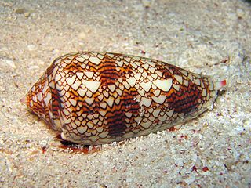
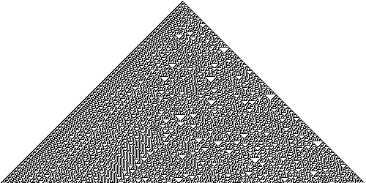
Cone shell pattern
Marine gastropod mollusc
Ref: 4
Notes:
Patterns of some seashells, like the ones in Conus and Cymbiola genus, are generated by natural cellular automata. The pigment cells reside in a narrow band along the shell's lip. Each cell secretes pigments according to the activating and inhibiting activity of its neighbour pigment cells, obeying a natural version of a mathematical rule. The cell band leaves the colored pattern on the shell as it grows slowly. For example, the widespread species Conus textile bears a pattern resembling Wolfram's rule 30 cellular automaton.
The color of the shell is yellowish brown, with undulating longitudinal lines of chocolate, interrupted by triangular white spaces. These last are irregularly disposed, but crowded at the shoulder, base and middle so as to form bands. The spire is similarly marked. The aperture is white.
The following pattern emerges from an initial state in a single cell with state 1 (shown as black) is surrounded by cells with state 0 (white).
Here, the vertical axis represents time and any horizontal cross-section of the image represents the state of all the cells in the array at a specific point in the pattern's evolution. Several motifs are present in this structure, such as the frequent appearance of white triangles and a well-defined striped pattern on the left side; however the structure as a whole has no discernible pattern. The number of black cells at generation is given by the sequence
1, 3, 3, 6, 4, 9, 5, 12, 7, 12, 11, 14, 12, 19, 13, 22, 15, 19, ... (sequence A070952 in OEIS)and is approximately .
As is apparent from the image above, Rule 30 generates seeming randomness despite the lack of anything that could reasonably be considered random input. Stephen Wolfram proposed using its center column as a pseudorandom number generator (PRNG); it passes many standard tests for randomness, and Wolfram uses this rule in the Mathematica product for creating random integers. Although Rule 30 produces randomness on many input patterns, there are also an infinite number of input patterns that result in repeating patterns. The trivial example of such a pattern is the input pattern only consisting of zeros. A less trivial example, found by Matthew Cook, is any input pattern consisting of infinite repetitions of the pattern '00001000111000', with repetitions optionally being separated by six ones. Many more such patterns were found by Frans Faase. See Repeating Rule 30 patterns.
Sipper and Tomassini have shown that as a random number generator Rule 30 exhibits poor behavior on a chi squared testwhen applied to all the rule columns as compared to other cellular automaton-based generators.^{[5]} The authors also expressed their concern that "The relatively low results obtained by the rule 30 CA may be due to the fact that we considered N random sequences generated in parallel, rather than the single one considered by Wolfram."

Slide 8
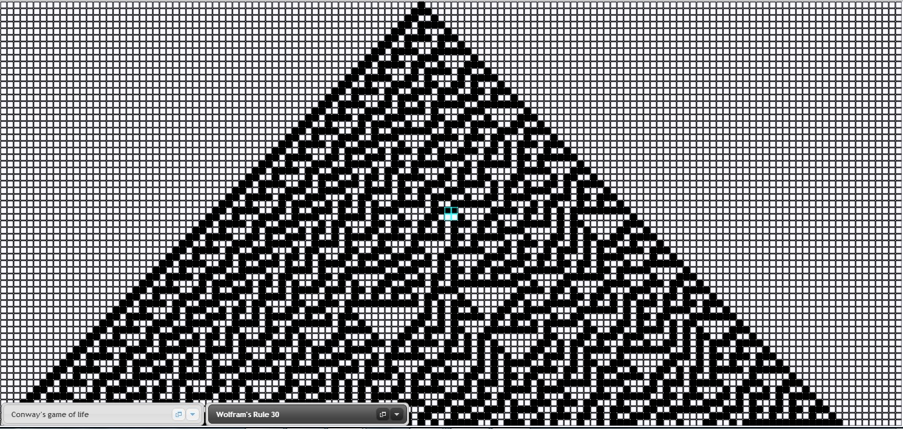
Our implementation (1)
Wolfram’s Rule 30

Slide 9
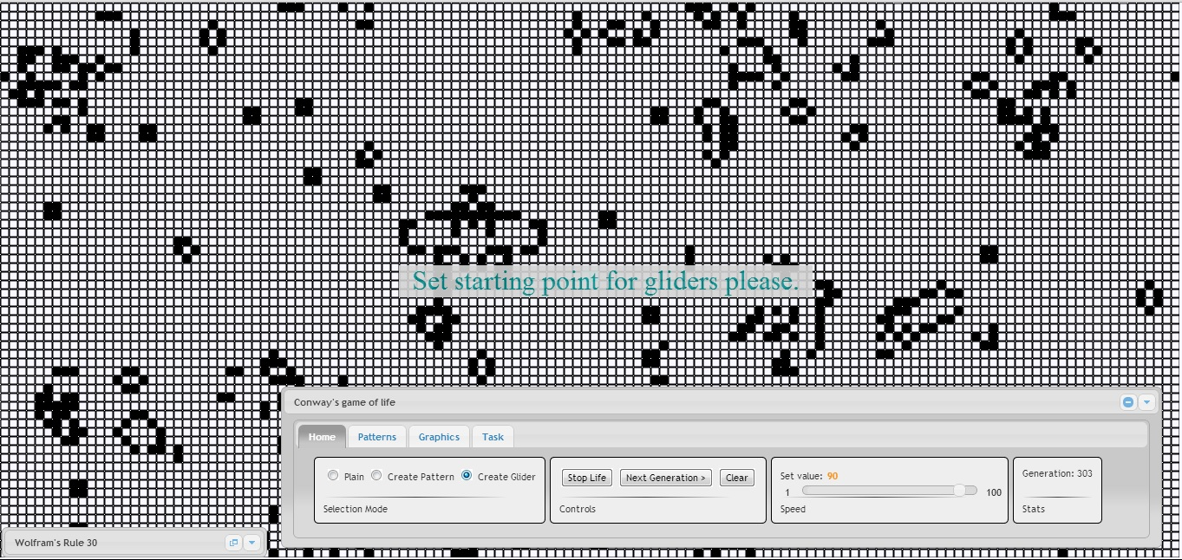
Our implementation (2)
Conway’s game of life

Slide 10
Thank you for your attention!
Do you have any questions ?

Slide 11
References
http://prezi.com/t95re3syuttc/cellular-automata-and-nature-inspired-computing/
http://en.wikipedia.org/wiki/Patterns_in_nature
http://news.brown.edu/pressreleases/2011/10/mollusks
http://en.wikipedia.org/wiki/Rule_30
http://www.cc.gatech.edu/~turk/my_papers/reaction_diffusion.pdf
http://www.ics.uci.edu/~eppstein/ca/wolfram.html

